Slide 1
UFCFFL-15-M Parallel computing presentation Elaine motley
“A modular and efficient hardware architecture for particle swarm optimization algorithm”
Nov 2018

Slide 2
Outline of Paper
Paper written Girma S Tewolde, Darrin M Hanna and Richard E Haskell (all MI, USA)
Submitted to Microprocessors and Microsystems: Embedded Hardware Design (MICPRO) (2012)
Basis of paper is to address shortcomings of software Particle Swarm Optimization (PSO) and develop modular hardware architecture suitable for embedded systems.
Design is such that as well as improving execution efficiency it should also be reusable for different optimization problems.
Parallelization scheme also implemented

Slide 3
Particle Swarm Optimization
Nature inspired algorithm, based on social behaviour of flocks of birds, schools of fish, animal herds, etc.
Positions of individual particles in the swarm represent candidate solutions for the optimization problem.
Velocities and positions of particles are modified so that the swarm can find a better quality solution.
Several versions of the PSO algorithm exist.
Paper uses constriction-factor variant of the algorithm (very widely used).
Each particle represented by a vector, and aim is to find pbest (personal best fitness)
Movement of particle is defined by its velocity vector

Slide 4


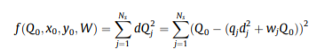
Benchmark Test Functions
3 test functions used:
Sphere test
Rosenbrock
Emission Source Localization (Real world problem)
From a total of N sensors monitoring a location, the fitness function captures the relative distance of the sensor from the emission location, sensor measurement readings, and estimated emission intensity at source location.

Slide 5
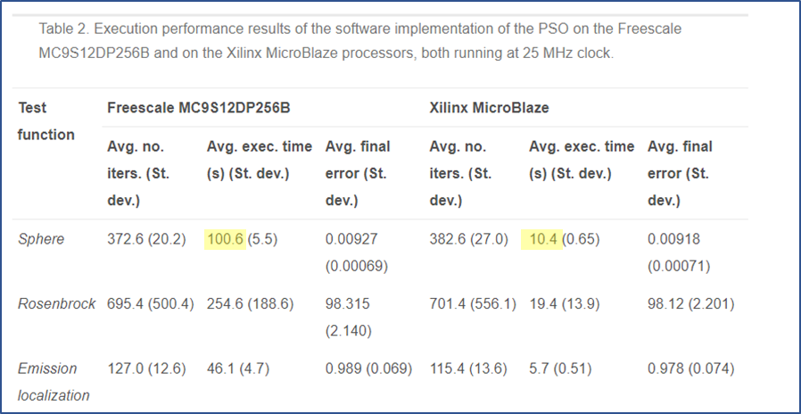
Software implementation of PSO
Performance was analysed on 2 different embedded processor platforms:
Freescale MC9S12DP256B (16-bit CPU, 12KB RAM, 256 KB Flash EEPROM, max clock frequency 25 MHz)
Xilinx MicroBlaze (customizable 32-bit RISC processor)
Clock speed limited to 25 MHz for easy comparison to the Freescale processor
Price to pay for increased performance of Xilinx processor, is the increased FPGA usage for the HW accelerators and corresponding increased power consumption.

Slide 6
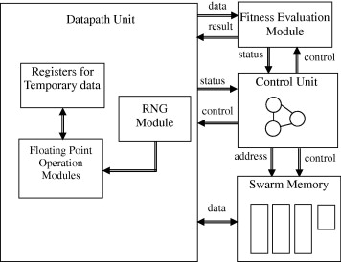
Hardware Architecture for PSO engine
Main target applications are “small, resource constrained embedded systems.”
eg sensor networks and mobile robotic applications.
High level architecture diagram:

Slide 7
Swarm Memory
Each particle represented by a vector in D-dimensional space.
Floating point numbers used to represent particle along each axis.
Memory requirement (N = swarm size):
Positions of particles (N x D)
Velocities of particles (N x D)
Personal best positions (N x D)
Best fitnesses (N)
Total = N x (3D + 1) (32 bit words)
N = 30 and D = 30 used. 2730 words = 10,920 bytes.

Slide 8
Other considerations for HW architecture
XC3S500E FPGA used (4656 slices, 20 BRAMS, 20 hardware multipliers)
16-bit RNG used; output is a fixed point number.
Fitness function evaluation module is a separate module so that the same PSO core can be used for different fitness functions.
“Mainly interested in quality of the solution and execution speed”.
No of iterations used to arrive at given error threshold and no. of system clock cycles taken.
Each benchmark function tested 20 times; different random no. seeds used each time.

Slide 9
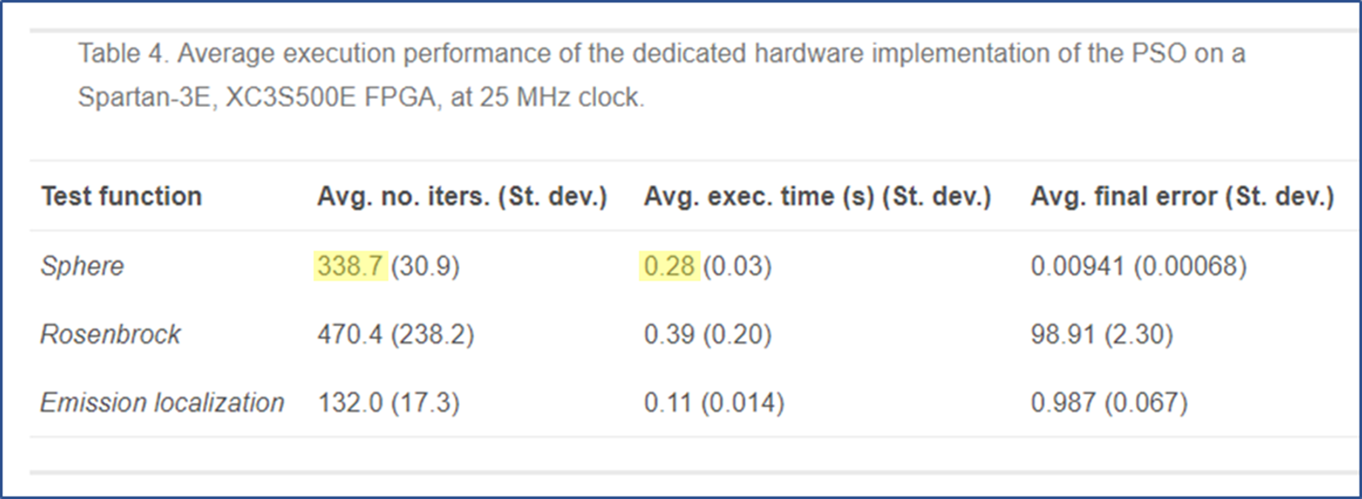
Results for hardware implementation
Sphere test speed up factors (compared to SW implementation)
359 over MC9S12DP256B (avg exec time = 100.6s)
37 on MicroBlaze (avg exec. Time = 10.4s)
Avg no. of iterations is lower, but within same “ballpark”.

Slide 10
Parallelization (1)
System is targeted for small embedded systems, so could not consider large clusters of computers.
Parallelization therefore limited to sub-swarms; dividing the entire swarm evenly.
Each sub-swarm has own computational resources.
Execution is asynchronous (sub-swarms communicate only when new global best discovered).
Important consideration is to consider how the sub-swarms communicate without the overhead compromising the performance gain.
Could have used shared memory for all particles to access global best data – but would probably cause a bottleneck.
Decided to let each sub-swarm have local copy of global best data.

Slide 11
Parallelization (2)
Communication infrastructure
Token passing approach considered, but would require dedicated hardware module in each sub-swarm to manage the token-passing and communication.
Decided instead to have a communication controller module which controls which sub-swarm can communicate.
Avoids data collision and maintains global best data in each sub-swarm.
Also allows for easier future expansion of the protocol.
Main disadvantage of using this method is that there is no guarantee that the overall global best is distributed when there are multiple simultaneous requests.
Hardware considerations
XC3S500E could only fit 2 threads for Sphere and Rosenbrock tests, and only 1 thread (sequential) for emission localization problem. Used Virtex II Pro XC2VP30 for threads > 2.

Slide 12
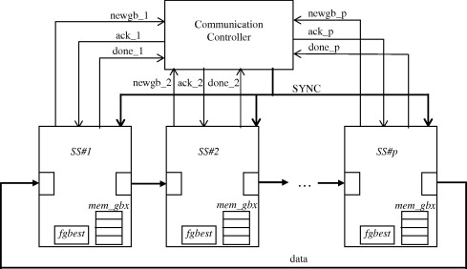
Parallelization (3)
Communication infrastructure diagram:
When sub-swarm discovers new global best, it sends communication request to controller. If no other sub-swarm has sent request, controller sends acknowledgement to the sub-swarm and sync pulse to all sub-swarms. Data communication can then start.

Slide 13
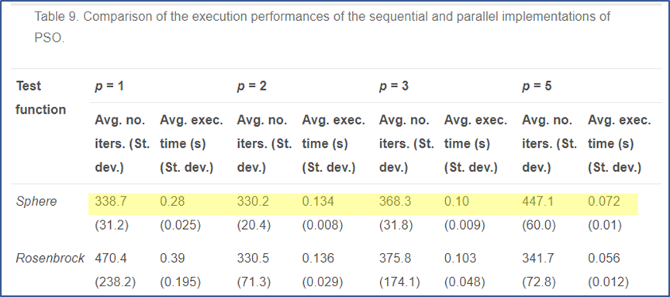
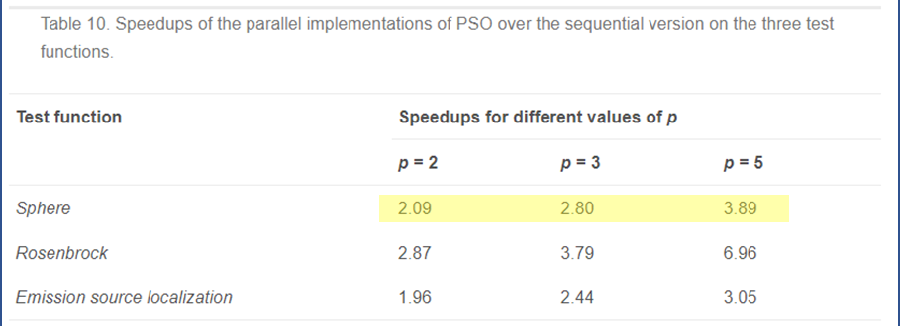
Parallelization (4)
Results for thread no. = 1, 2, 3, 5 (no p = 4 as swarm size N (30) not evenly divisible by 4.
Parallelization shows speedups in execution time over serial implementation.
In the Sphere test, for p = 2, the speedup is about equal to the no. of threads.
In the Sphere test, for p > 2, speedups are lower than the no. of threads.
Highest speedups are on Rosenbrock function for all degrees of parallelism.
Different factors could effect the results, such as the nature of the problem, or how well the sub-swarms divide the search space.
Better strategies required for partitioning the search space.

Slide 14
Paper Conclusions
Presented fast, efficient, modular & portable PSO engine.
General purpose PSO core can be utilized for different objective functions.
Sub-swarm parallelization scheme successfully implemented.
Further work identified:
Different approaches for partitioning the global search space to reduce total execution effort.
Ways to simplify PSO strategies to enhance potential speedup.

Slide 15
Paper Evaluation
+
Logical order to structure
Design was successful
Clear description of parallelization considerations.
-
Description of the component of fig 1. didn’t exactly match the diagram (eg “Fixed to float converter module” not labelled as such.)
No table to directly compare software implementation to hardware implementation.
Figures confusing in one of the tables (Table 6) – no context given.

Slide 16
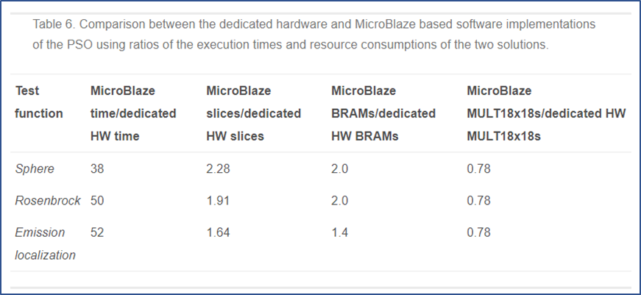
References
Tewolde, G.S., Hanna, D.M. and Haskell, R.E. (2012) A modular and efficient hardware architecture for particle swarm optimization algorithm. Microprocessors and Microsystems: Embedded Hardware Design (MICPRO) 36, pp 289-302.
Table 6 (p297)

